Slide 1
Enterprise Content Management
Name
Title
Company

Slide 2
Agenda
Introduction to ECM in SP2013
eDiscovery
Target Scenarios
Extensibility
Site Mailbox
Content Management Interoperability Services Connector
Managed Metadata
Managed Metadata Service & Taxonomy Improvements
Developing with Managed Metadata

Slide 3
Introduction

Slide 4
ECM in SharePoint Server 2010
SharePoint 2007 introduced ECM to the platform
SharePoint 2010 took 2007’s capabilities and featurized them for use across the platform
ECM for the masses
No longer tied to Document Repositories or Records Centers
SharePoint 2010 introduced new capabilities
In-Place Records Management
Document Sets
Unique Document ID Service
Content Organizer
Notes:
Enterprise Content Management (ECM) capabilities were introduced to the platform in SharePoint 2007 in adding basic check-in/check-out and versioning capabilities as well as things such as the Report Center, Document Center site templates, holds and other capabilities. SharePoint 2010 expanded on these capabilities by moving many of the ECM capabilities to Features which enabled customers to leverage them within any type of SharePoint site as well as introducing things such as in-place records management, document sets, unique document ID’s and the content organizer.

Slide 5
SharePoint 2013 & Exchange ECM - Big Bets
eDiscovery
In place holds in SP & Exchange
Integrated, enterprise wide case management
Site Mailboxes
Work on mail and documents together
SharePoint & Outlook desktop client
Meet Compliance Demands
Retention/compliance across stores
Notes:
In the SharePoint 2013 and Exchange releases, Microsoft is banking on two major investment areas to their ECM offering. These two areas are eDiscovery & Site Mailboxes.

Slide 6
eDiscovery

Slide 7
eDiscovery
eDiscovery is the process of finding content relevant to a specific topic
For example: legal action / litigation
Companies also employ internally
Ensure they are in compliance
Ensure the appropriate policies are in place
Ensure they understand their IT & content sources
Notes:
An ECM implementation has two sides to the solution: (1) getting content classified and into the system and (2) being able to find and act on the content that is in the system. eDiscovery addresses the latter part of this need. eDiscovery is the process of finding relevant content, typically in responding to addressing a legal even, reviewing that content and exporting it for further use.

Slide 8
eDiscovery Process
Preserve
Create Case
Apply Hold
Search
Query
De-duplicate
Review
Visualize
Read
Export
Save as PDF/TIFF
Print
Discovery accounts for ~35% of total litigation costs in the US (Gartner) and is one of the top drivers for moving email and documents into third party archiving solutions. Given the growth of this area, pure-play discovery software and discovery-enabled are expected to be a $2.1b business by 2013. - Gartner
Notes:
FAA requires every single piece of paper used in the process of manufacture must be included and handed over at purchase. Each plane sold by Boeing requires this massive file handed to the purchaser. How do you find every document related to manufacture of a single plane? It’s easy to see that there are significant problems that can be solved through eDiscovery, this is where 2.1b comes from.

Slide 9
SharePoint 2013 eDiscovery
Meeting Compliance Demands
Centralize Management
Reduce Costs
Empower Legal Teams
Notes:
In SharePoint 2013, eDiscovery can be seen as having three main pillars or goals under the top-level goal of meeting compliance demands:
Centralizing the management of content
Reducing the costs associated with the discovery process
Empowering the legal teams to respond and act more quickly to legal events

Slide 10
Centralize Management
Discovery Center in SharePoint | Unified Preserve, Search and Export
Exchange Web Services | Connect to Exchange to get mailbox data
Lync Archiving to Exchange | Exchange is the compliance store for Lync
Search Infrastructure | Exchange and SharePoint use the same search platform
Unified Discovery across Exchange, SharePoint & Lync
Find it all in one place (unified console)
Find more (in-place discovery returns the richest data)
Find it without impacting the user (give legal team discovery, leave IWs alone)
Notes:
SharePoint 2013 introduces a new site for managing discovery cases and holds. The Discovery Center site template creates a portal through which you can access discovery cases to conduct searches, place content on hold, and export content. For each case, you create a new site that uses the Discovery Case site template. Each case is a collaboration site that includes a document library which you can use to store documents related to the management of the case. In addition, you can associate the following things with each case:
Sources: Exchange mailboxes, SharePoint sites, or file shares from which content can be discovered.
Queries: The search criteria, such as author, date range, and free-text terms, as well as the scope of the search. Queries are used to identify content to export.
Discovery sets: Combinations of sources, queries, and whether or not to preserve content. Discovery sets are used to identify and preserve content.
Exports: A list of all of the exports that have been produced relating to the case.
When there is a new need for discovery — for example, a legal case or an audit — a user with the appropriate permission can create a new case, add sources of information to be searched, create queries to identify the specific material to be located, and then execute the queries. The user can then preserve the sites and mailboxes in which content was discovered, retain the items that matched the queries, and export the items. When the case is closed, all of the holds associated with the case are released.

Slide 11



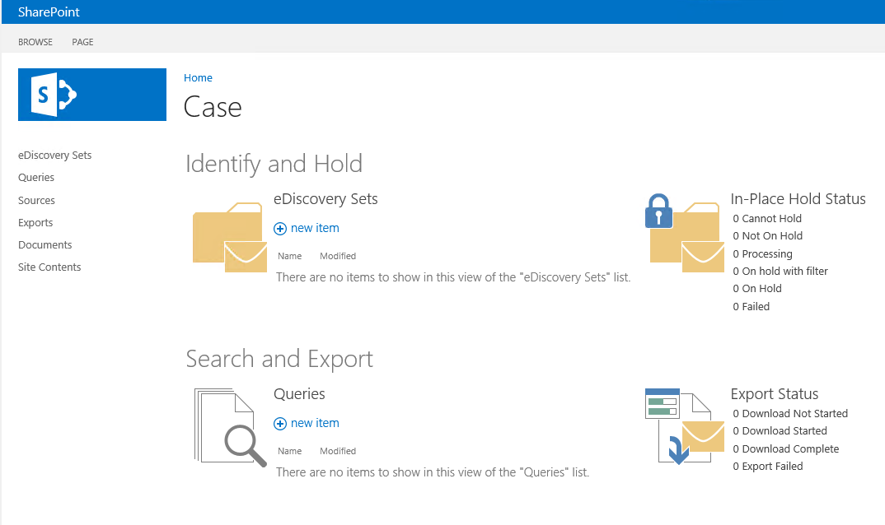






eDiscovery Architecture
Mailboxes
Lync IMs
All SharePoint content
Exported data
Notes:
Connection to Exchange done by usign echange web services.
Users usign ediscovery have to have specific permissions in exchange side

Slide 12
Reduces Cost with SP2013 eDiscovery
Reduce data volumes with targeted search
SharePoint leverages search to discover content and place holds on content
Decrease need for 3rd party discovery tools and archives
By keeping content (using search) in SharePoint, Exchange & Lync longer, reduces the need for exporting to these 3rd party tools
Minimize storage requirements with in-place holds
Content loses fidelity when it is moved from system to system
By preserving content in-place, reduce storage costs
Notes:
With a search platform in SharePoint 2013 as well as in Exchange, Microsoft can now help to reduce the volumes of content that customers are working with using these tools. Many organizations use 3rd party tools for discovery and archives which adds time, cost and demands for collecting content. By leaving the content in the source, the content won’t lose fidelity in moving it between systems. This will also lower cost as you don’t have duplication of content. In addition, this also reduces the need to procure specialized tools for discovery & archiving of content.

Slide 13
Empower Legal Teams
Delegate discovery to legal team
Remove overhead from IT
Respond quickly and in full fidelity with real-time data access
With delegation to legal team, they can act on level events without having to involve IT
Discovery without impacting the users
Using SharePoint search, no longer have the time consuming process of gathering content from users to put into a 3rd party search / discovery system
Notes:
A common concern legal teams have is that IT has all the control in the systems. When a legal event occurs, the legal team frequently needs to act quickly and by having to work with the IT team to find content and extract relevant content, the process is slowed down. This process can take weeks while the legal team and IT identify the repositories, gain access and work with the users and content owners to extract the relevant content.
By empowering legal teams they can act more quickly and respond to legal events without having to involve IT. This enables the legal team to gain access and insights early in the process without having to wait for a long period of time. In addition, using search it allows the legal team to find the relevant content without having to disrupt the users of the system.

Slide 14
Targeted eDiscovery Scenarios in SharePoint 2013
Preserve
Protect content in real time
Search
Find relevant content quickly
Export
Transfer relevant content for review & production
Case Management
Organize legal matters
Notes:
In SharePoint 2013, Microsoft wanted to target some specific eDiscovery scenarios across SharePoint, Exchange & Lync:
Preservation: Being able to protect content in real time in place without affecting users & preserving the content in a defensible way.
Search: Being able to find content you are looking for, identify what’s important for your case, being able to leverage the included search capabilities of the platforms to find the content that’s out there.
Export: At some point the legal team will need to export the content out of the system(s) to hand it off for review or to other parties in the legal event.
Case Management: Provide a single centralized place where you can organize, manage and perform the process.

Slide 15
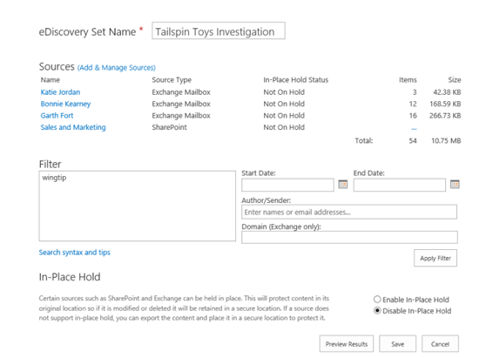
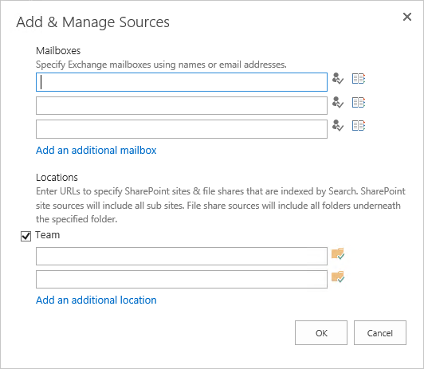
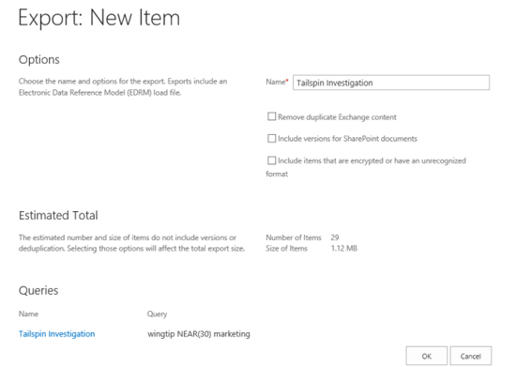
Add, Manage & Export Discovery Sets
Notes:
Enterprise-wide eDiscovery
With SharePoint Server 2013 you can centrally manage eDiscovery across multiple SharePoint farms, Exchange servers, and file shares. From one discovery center you can:
Create a case, define a query, and search SharePoint Server 2013, Exchange Server, and file shares throughout the enterprise for content that matches the query.
Export all of the content that was identified.
Preserve items in place in SharePoint Server 2013 or Exchange Server.
Track statistics related to the case.
To implement eDiscovery across the enterprise, you first select one farm to host the discovery center. The Search Service application that is associated with this farm becomes the central Search Service application, for eDiscovery purposes. You create a proxy to the central Search Service application in each SharePoint Server farm that contains discoverable content, and configure the central Search Service application to crawl file shares that contain discoverable content. SharePoint Server 2013 automatically discovers the connection to Exchange Server. Any content from SharePoint Server 2013, Exchange Server, or a file share that is indexed by the central Search Service application or by Exchange Server can be discovered from the discovery center.
Discovery Export
SharePoint Server 2013 includes the Discovery Download Manager, a Microsoft Windows® 7 application that you can use to export the results of an eDiscovery search for later import into a review tool. The Discovery Download Manager can export all of the content that is associated with a discovery case, including:
Documents: Documents are exported from file shares. Documents and their versions are exported from SharePoint Server 2013.
Lists: If a list item was included in the eDiscovery query results, the entire list is exported as a comma-separated values (.csv) file.
Pages: SharePoint Server 2013 pages, such as wiki pages or blogs, are exported as MIME HTML (.mht) files.
Exchange objects: Items in an Exchange Server 2013 mailbox, such as tasks, calendar entries, contacts, email messages and attachments, are exported as a personal storage (.pst) file.
An XML manifest that conforms to the Electronic Discovery Reference Model (EDRM) specification provides an overview of the exported information.

Slide 16
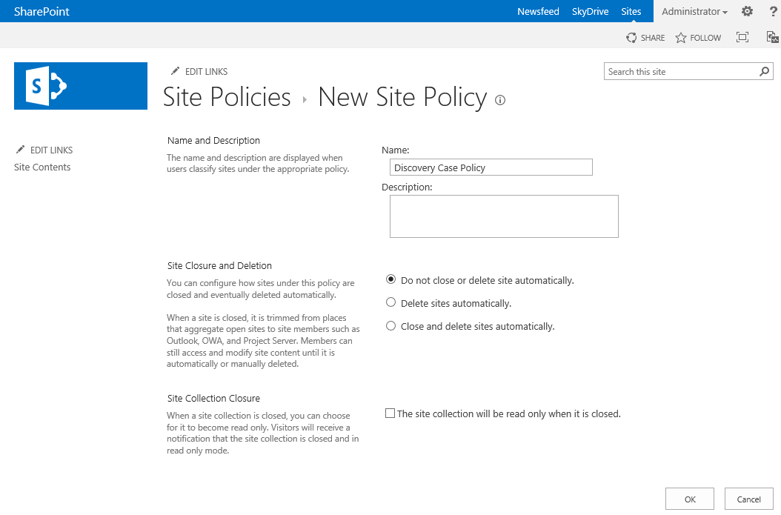
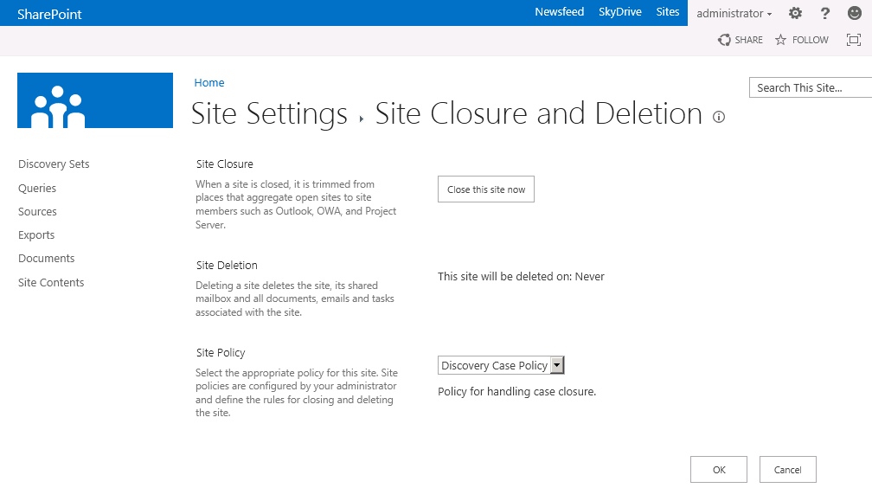
Site Based Compliance & Preservation
Compliance officers create policies, which define:
The retention policy for the entire site and the Site Mailbox, if one is associated with the site
What causes a project to be closed
When a project should expire
Notes:
Compliance features of SharePoint Server 2013 have been extended to sites. You can create and manage retention policies in SharePoint Server 2013, and the policies will apply to SharePoint sites and any Exchange site mailboxes that are associated with the sites.
Compliance officers create policies, which define:
The retention policy for the entire site and the site mailbox, if one is associated with the site.
What causes a project to be closed.
When a project should expire.
When a project begins, the project owner creates a SharePoint site and an Exchange site mailbox. The project owner selects the appropriate policy template, and invites team members to join the project. As the team adds documents to the site, sends email messages, and creates other artifacts such as lists, these items automatically receive the correct retention policies. When the work has been completed, the project owner closes the project, which removes the project's folders from the team members' Outlook user interface. After a certain period of time, as specified by the policy, the project expires, and the artifacts associated with the project are deleted.
In SharePoint Server 2013, content that is placed on hold is preserved, but users can still modify it. The state of the content at the time of preservation is recorded. If a user modifies the content or even deletes it, the original, preserved version is still available. Regular users see the current version of the content; compliance officers who have permission to use the eDiscovery features of SharePoint Server 2013 are able to access the original, preserved version.
Preserving content is similar to placing it on hold, with the following enhancements:
Documents, list items, pages, and Exchange Server 2013 mailboxes can be preserved.
Preservation is done at the level of a site. Preserving a site preserves the contents of the site.
Users can continue to work with content that is preserved. The content remains in the same location, and users can edit, delete, and add new content.
A user with the permission to perform eDiscovery can access the original version of preserved content.
You do not have to preserve an entire site or mailbox. You can specify a query to define the hold scope, and preserve only the content that matches the query.

Slide 17
SharePoint 2013 eDiscovery Extensibility
eDiscovery market filled with spot solutions
SharePoint 2013 provides a platform for eDiscovery
Example scenarios:
Notify owner of content when legal hold established
Prompt user to complete interview when included in a case
Export content from case search with custom manifest file
Creating industry or company specific search experiences
Industry specific reporting & analytics
Notes:
The eDiscovery market is filled with vendors who contain products that serve specialized needs & functions… rarely do you find organizations using a single monolithic product.
Out-of-the-box SharePoint 2013 eDiscovery allows organizations to create collections of content for a legal case, categorize and refine the content using search. This content can then be exported to a user’s workstation.
SharePoint 2013 provides a platform for eDiscovery. ISVs can extend the SharePoint 2013 eDiscovery offering by providing industry specific solutions, additional reporting & analytics solutions as well as customizing the user experience.

Slide 18
Document Sets & CMIS Connector Improvements
Document Set Improvements
Supports OneNote notebooks & folders
Supports CBQ & CBS Web Parts (new & improved)
CSOM API for working with document sets
CMIS: Content Management Interoperability Services Connector
Introduced as part of SharePoint Admin’s Toolkit for SharePoint 2010
Completely redesigned in SharePoint 2013
Support for CMIS 1.0
Supports sites based on claims-based authentication + many others
Notes:
Document Sets:
Document sets now support Microsoft OneNote notebooks and folders, in addition to supporting feature breadcrumb behavior that matches breadcrumb behavior in SharePoint Server 2013. Document sets also support Content By Query Web Part (CQWP) enhancements and are compatible with the new Content by Search (CBS) Web Part.
Developers can create fully functioning document sets with web services and with the client object model (CSOM) that include provisioned default documents and synchronized metadata. You can also write code to identify an item inside a document site or identify the document set where a specific item is found.
Content Management Interoperability Services Connector:
The Content Management Interoperability Services (CMIS) connector was introduced as part of the SharePoint Administrator's Toolkit shortly after SharePoint Server 2010 was released. The connector has been completely redesigned in SharePoint Server 2013. Enhancements to the CMIS connector in SharePoint Server 2013include the following:
Support for CMIS 1.0.
A producer component, instead of both consumer and producer components.
Functions in most authoring environments where the SharePoint list web services work.
Support for interoperating in a Claims environment.
Support for interoperating with other authoring protocols, including Anonymous AuthN, Bsic AuthN, NTLM AuthN, Digest AuthN, Kerberos Protocol Transitioning/Constrained Delegation, Windows Claims, Claims Multi-Auth, and Claims Mixed Auth.

Slide 19
Site Mailbox: Exchange & SharePoint Together
Documents are stored in SharePoint
Emails are stored in Exchange
Site Mailboxes can receive emails and have their own email address
Easy access to both from Outlook and SharePoint
Unified compliance policy applies to both
Notes:
Make sure to explain that
You will get access to docs and emails for a project together in Outlook
That the actual docs remain on SharePoint
All changes to documents (edits, deletes) happen right on SharePoint even if started from Outlook

Slide 20
Taxonomies & Managed Metadata

Slide 21
Managed Metadata Improvements
Metadata leveraged throughout SharePoint 2013
New pages introduced so not everyone has to use Term Store Manager to modify taxonomies
Permissions for groups
SharePoint 2010 allowed read
SharePoint 2013 supports read/write
Numerous features based on taxonomy targeting WCM scenarios
Ability to flag a term set’s “intended use”
Taxonomy API exposed via CSOM

Slide 22
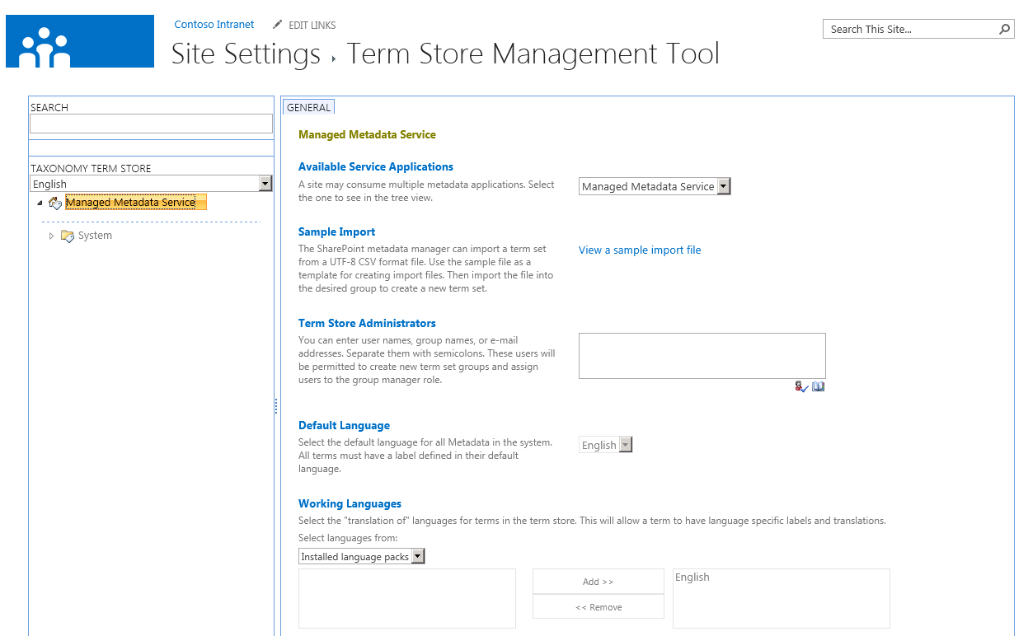
Enterprise Metadata Management
Metadata as enabler for different functionalities
Navigation, term and search driven pages, etc.
Numerous new capabilities for term store manager to enhance term usage models
Multilingual improvements & new capabilities
Dataview editing support included

Slide 23
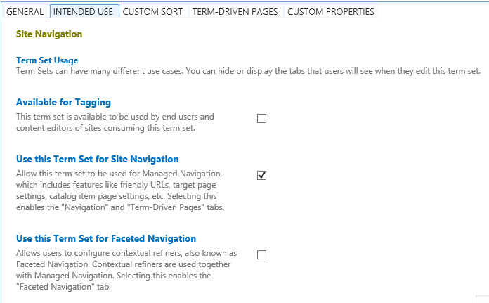
Term Store Manager Changes in SharePoint 2013
Cross site collection term access for private groups
Possibility to link different site collections to see others terms
Pinning terms
Read only reuse of the term in alternative location in the hierarchy
UI for custom property editing
Specific by location properties
Indication of the term set usage for other SharePoint 2013 uses
Additional Multilingual support (flexible LCID & automated translation support)
Block users from using keywords outside of specific term set
Notes:
Block users from using this keyword outside the context of its new Term Set destination.

Slide 24
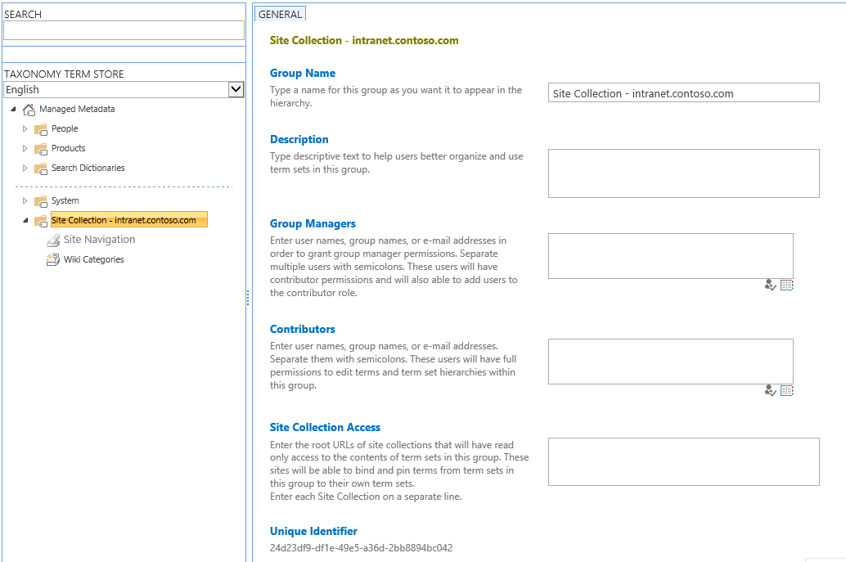
Cross SPSite Access to Private Local SPSite Groups
Notes:
Managed Metadata term sets are categorized as local or global term sets. A global term set is one that can be used by any site collection connected to the MMS service application. A local term set is one that while stored in the MMS service application, is only available to a specific site collection.
SharePoint 2013 now allows users to make a local term set available to other site collections by specifying the URL or the site collection.

Slide 25
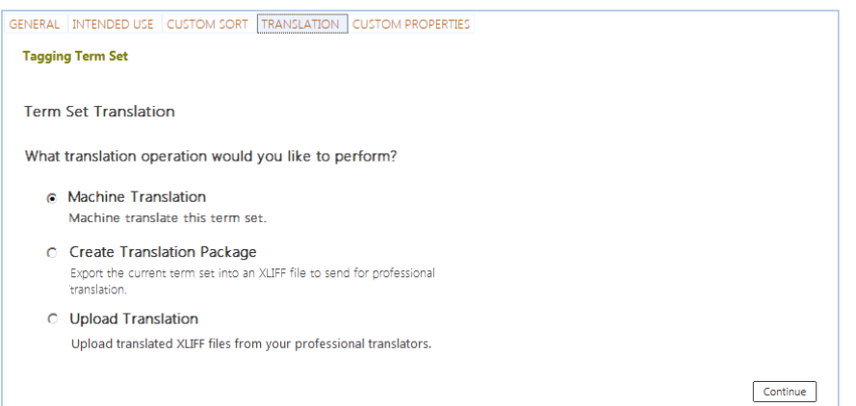
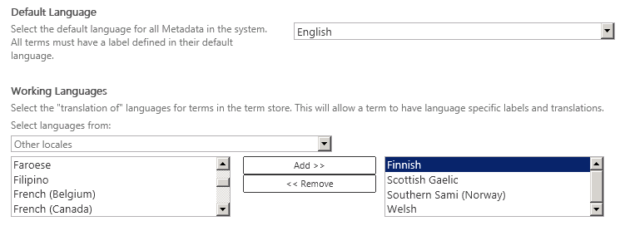
Multilingual Support Improvements
SharePoint 2010: Languages only available after language packs have been installed
SharePoint 2013: Possibility to use any LCID as language identifier for maximum flexibility without limitations or requirements of language packs
Possibility to utilize translation service for automated term translations
Notes:
Expand the current model where only installed language packs are available to include the 40 SharePoint LCIDs and the 138 other LCIDs. Users of the Term Store can use any of these to label their terms.

Slide 26
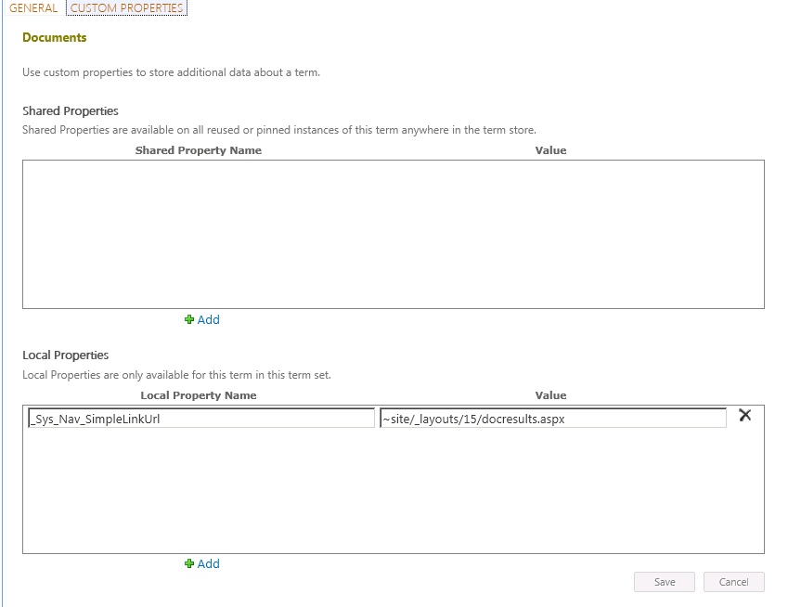
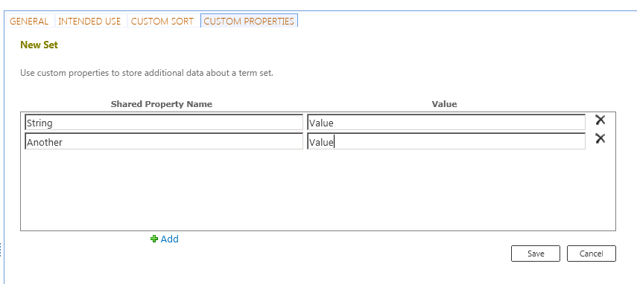
Shared and Local Properties
Additional properties can be defined for term sets and for terms
Terms can have specific local properties
Not available for reused / pinned
Notes:
In SharePoint 2010, terms in term sets had properties that could be managed and accessed via the Taxonomy API. However these properties were not accessible via the browser.
SharePoint 2013 now includes the ability to add, edit and manage the properties of terms and term sets through the bowser. The properties can also be classified as shared properties, or those that are available in all reused and pinned instances of the term wherever it is used throughout a term store or as a local property in that it is only accessible for the term within the term set.

Slide 27
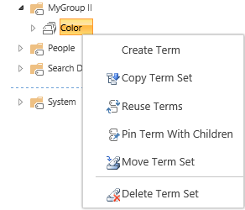
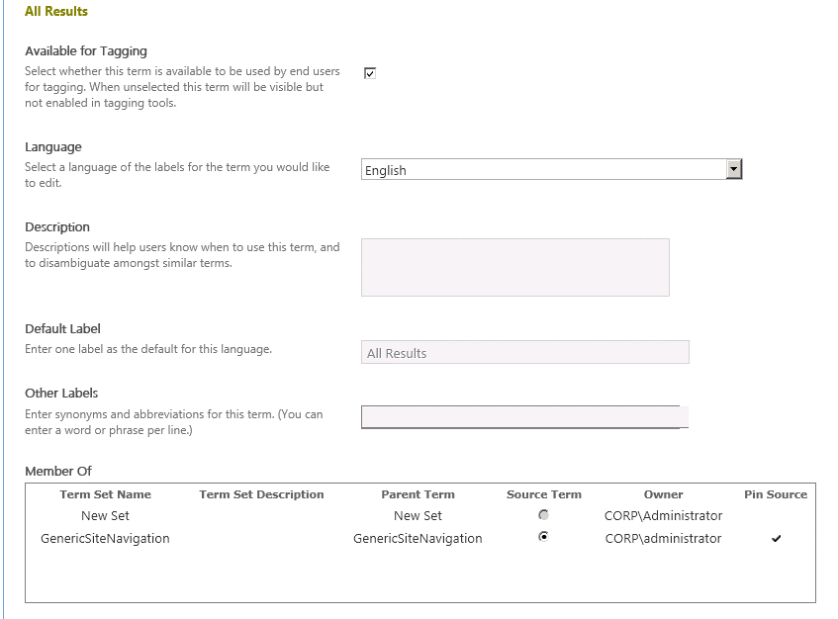
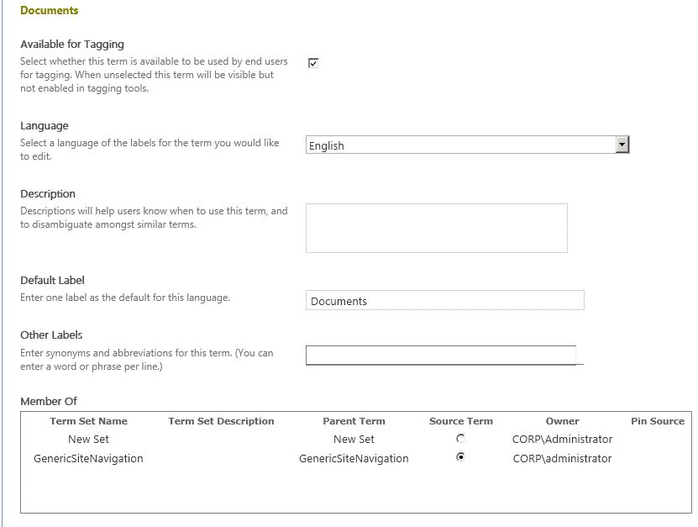
Pinned Terms vs. Term Reuse
Pinned terms: Read only usage of the terms in other places in term hierarchy
Pinned term
Reused Term
Notes:
In SharePoint 2010, users could reuse terms (and all terms nested under that term) in other locations in the term hierarchy. Once these terms were reused, they could be modified in both locations and changes would be seen anywhere the terms were reused.
SharePoint 2013 takes the concept of term reuse a step further and introduces term pinning. A pinned term is just like a term that is reused except it is read only & cannot be changed in the location where the term is used.

Slide 28
Managed Metadata CSOM
SharePoint 2013 CSOM has support for taxonomy
Add references to:
Microsoft.SharePoint.Client.dll
Microsoft.SharePoint.Client.Runtime.dll
Microsoft.SharePoint.Client.Taxonomy.dll
CSOM usage is usage very similar to server-side taxonomy API
Obtain TaxonomySession reference followed by
Term Store
Group
Term Set
Terms
Load objects & collections as necessary
Notes:
The ECM client object model is available in .NET Framework libraries (.NET Framework client and Microsoft Silverlight) and JavaScript script files. The client object model enables developers to access metadata and other ECM APIs from the client. This is especially useful in scenarios where reading content is a higher priority than administering it or authoring it, and where SharePoint Server 2013 needs to enable a cloud scenario (SharePoint Online) for a subset of functionality that is available on-premises.

Slide 29
SharePoint 2013 Managed Metadata
demo

Slide 30
Summary
eDiscovery – Introduction & Overview in SharePoint 2013
eDiscovery – Target Scenarios
eDiscovery – Extensibility
Content Management Interoperability Services Connector
Managed Metadata Service & Taxonomy Improvements
Developing with Managed Metadata

Slide 31
Q&A

Slide 32

© 2012 Microsoft Corporation. All rights reserved. Microsoft, Windows, Windows Vista and other product names are or may be registered trademarks and/or trademarks in the U.S. and/or other countries.
The information herein is for informational purposes only and represents the current view of Microsoft Corporation as of the date of this presentation. Because Microsoft must respond to changing market conditions, it should not be interpreted to be a commitment on the part of Microsoft, and Microsoft cannot guarantee the accuracy of any information provided after the date of this presentation. MICROSOFT MAKES NO WARRANTIES, EXPRESS, IMPLIED OR STATUTORY, AS TO THE INFORMATION IN THIS PRESENTATION.

